Slide 1
1D full wave simulation in magnetic plasma
Xinhang Xu
9/2/2024

Slide 2
Motivation
1.Analysis Mode Conversion in magnetic plasma
2.Numerical Simulation for plasma diagnose
3.More efficient and available compared to 3D fdtd simulation in magnetic confined plasma

Slide 3
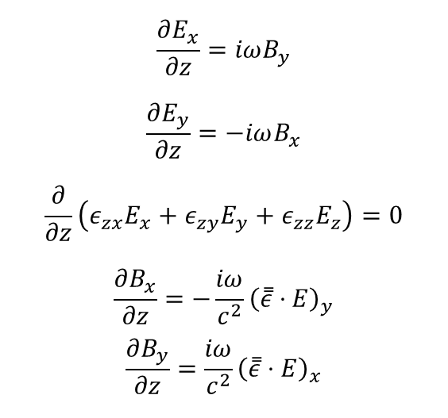
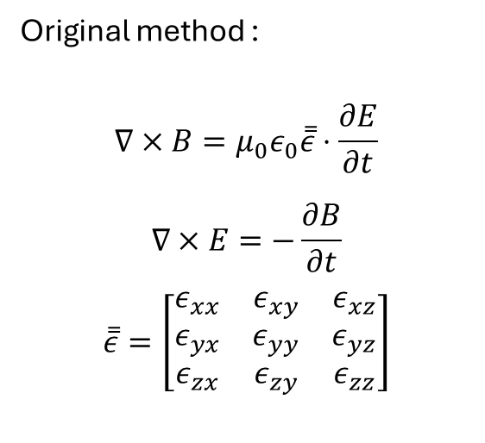
Update from Frequency region to Time region
Original method :
$$∇×B=μ_{0}ε_{0}\overset{̿}{ε}⋅\frac{∂E}{∂t}$$
$$∇×E=−\frac{∂B}{∂t}$$
$$\overset{̿}{ε}=\left[\begin{matrix}ε_{xx} & ε_{xy} & ε_{xz} \\ ε_{yx} & ε_{yy} & ε_{yz} \\ ε_{zx} & ε_{zy} & ε_{zz}\end{matrix}\right]$$
$$\frac{∂E_{x}}{∂z}=iωB_{y}$$
$$\frac{∂E_{y}}{∂z}=−iωB_{x}$$
$$\frac{∂}{∂z}\left(ε_{zx}E_{x}+ε_{zy}E_{y}+ε_{zz}E_{z}\right)=0$$
$$\frac{∂B_{x}}{∂z}=−\frac{iω}{c^{2}}{\left(\overset{̿}{ε}⋅E\right)}_{y}$$
$$\frac{∂B_{y}}{∂z}=\frac{iω}{c^{2}}{\left(\overset{̿}{ε}⋅E\right)}_{x}$$
Fourier Transformer
Advantage:
1.Quick mode conversion analysis
2.easy to write code
Disadvantage:
1.Only one frequency during the simulation
2.Can’t apply to many diagnose analysis such as DBS and USPR
2.Hard to analysis reflect signal from cutoff layer.
3.No time resolution

Slide 4
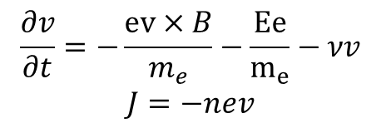

Upgrade method :
$$∇×E=−μ_{0}\frac{∂H}{∂t}$$
$$∇×H=ε_{0}\frac{∂E}{∂t}+J$$
$$\frac{∂J}{∂t}=ω_{ce}×J+ε_{o}ω_{pe}^{2}E−νJ$$
Electron velocity equation:
$$\frac{∂v}{∂t}=−\frac{ev×B}{m_{e}}−\frac{Ee}{m_{e}}−νv$$
$$J=−nev$$
Advantage :
1. Time evolution analysis
2. Closer to real physics problem
3. This mode is capable of numerically simulating diagnostic physics such as USPR and DBS.

Slide 5
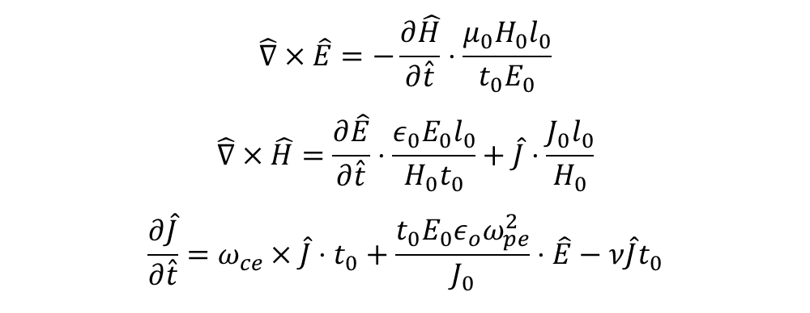
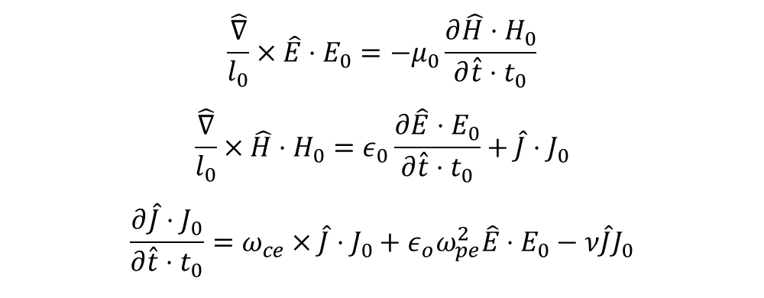
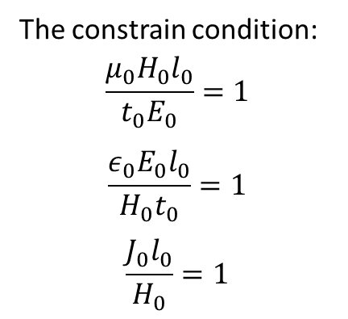
Numerical Method:
1. dimensionless equations by normalizing with characteristic parameters:
$$\frac{\hat{∇}}{l_{0}}×\hat{E}⋅E_{0}=−μ_{0}\frac{∂\hat{H}⋅H_{0}}{∂\hat{t}⋅t_{0}}$$
$$\frac{\hat{∇}}{l_{0}}×\hat{H}⋅H_{0}=ε_{0}\frac{∂\hat{E}⋅E_{0}}{∂\hat{t}⋅t_{0}}+\hat{J}⋅J_{0}$$
$$\frac{∂\hat{J}⋅J_{0}}{∂\hat{t}⋅t_{0}}=ω_{ce}×\hat{J}⋅J_{0}+ε_{o}ω_{pe}^{2}\hat{E}⋅E_{0}−ν\hat{J}J_{0}$$
2.rearrange the normalized parameters to one side :
The constrain condition:
$$\frac{{μ_{0}H}_{0}l_{0}}{t_{0}E_{0}}=1$$
$$\frac{ε_{0}E_{0}l_{0}}{H_{0}t_{0}}=1$$
$$\frac{J_{0}l_{0}}{H_{0}}=1$$
$$\hat{∇}×\hat{E}=−\frac{∂\hat{H}}{∂\hat{t}}⋅\frac{{μ_{0}H}_{0}l_{0}}{t_{0}E_{0}}$$
$$\hat{∇}×\hat{H}=\frac{∂\hat{E}}{∂\hat{t}}⋅\frac{ε_{0}E_{0}l_{0}}{H_{0}t_{0}}+\hat{J}⋅\frac{J_{0}l_{0}}{H_{0}}$$
$$\frac{∂\hat{J}}{∂\hat{t}}=ω_{ce}×\hat{J}⋅t_{0}+\frac{t_{0}{E_{0}ε}_{o}ω_{pe}^{2}}{J_{0}}⋅\hat{E}−ν\hat{J}t_{0}$$

Slide 6


Finally ,the normalized numerical equation is
$$\hat{∇}×\hat{E}=−\frac{∂\hat{H}}{∂\hat{t}}$$
$$\hat{∇}×\hat{H}=\frac{∂\hat{E}}{∂\hat{t}}+\hat{J}$$
$$\frac{∂\hat{J}}{∂\hat{t}}=ω_{ce}×\hat{J}⋅t_{0}+{t_{0}^{2}ω}_{pe}^{2}⋅\hat{E}−ν⋅\hat{J}t_{0}$$
Consider only one dimension along z axis, we have
$$\frac{∂{\hat{H}}_{y}}{∂\hat{t}}=−\frac{∂{\hat{E}}_{x}}{∂\hat{z}}$$
$$\frac{∂{\hat{H}}_{x}}{∂\hat{t}}=\frac{∂{\hat{E}}_{y}}{∂\hat{z}}$$
$$\frac{∂{\hat{E}}_{y}}{∂\hat{t}}=\frac{∂{\hat{H}}_{x}}{∂\hat{z}}−{\hat{J}}_{y}$$
$$−\frac{∂{\hat{E}}_{x}}{∂\hat{t}}=\frac{∂{\hat{H}}_{y}}{∂\hat{z}}+{\hat{J}}_{x}$$
$$\frac{∂{\hat{E}}_{z}}{∂\hat{t}}=−{\hat{J}}_{z}$$
$$\frac{∂\hat{J}}{∂\hat{t}}=ω_{ce}×\hat{J}⋅t_{0}+{t_{0}^{2}ω}_{pe}^{2}⋅\hat{E}−ν⋅\hat{J}t_{0}$$
EH grid distribution
With CPML(Convolution Perfect Match Layer) absorbing boundary method
Notes:
Attention :
only available along the k direction where the wavefront vertical to k and the phase is only related to the distance along k .
As a results, one need to combine the 1d fdtd program with ray-tracing code .

Slide 7
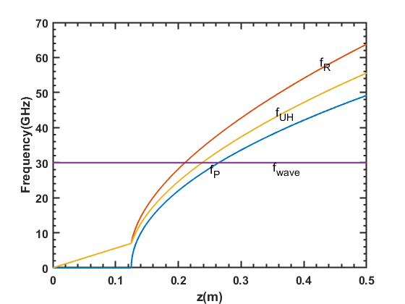
Numerical Test
X mode Cutoff Test
Source frequency :30GHz
Cutoff layer
ne ,B distribution
Characteristic frequency

Slide 8



Simulation Results
$$B_{0}$$
$$z$$
$$E_{x}$$
The EMW is blocked at the cutoff layer

Slide 9
O mode Cutoff Test
Source frequency :30GHz

Slide 10
Simulation Results

Slide 11
Application:
USPR simulation
Density and Magnetic distribution
Plasma frequency distribution
Launch a pulse from here
Plasma region

Slide 12
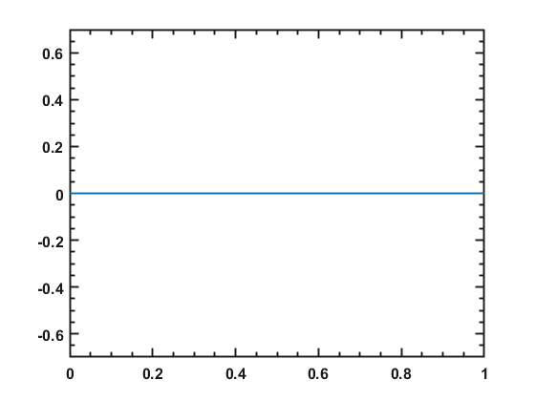
Movie show:
USPR signal propagation in the plasma
Ex
z/m

Slide 13
Launch Wave
Receive Wave

Slide 14
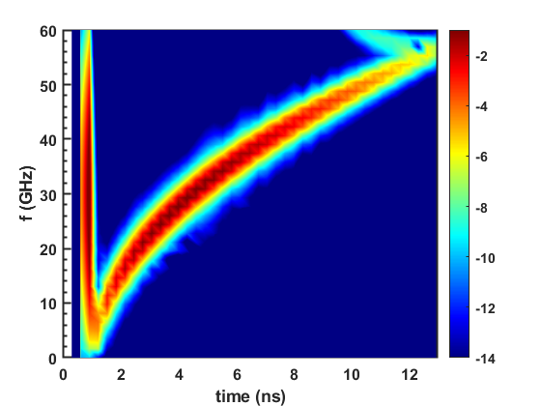
Sample Point Signal
Short time Fourier analysis of Sample Point signal

Slide 15
CODE BENCHMARK

Slide 16

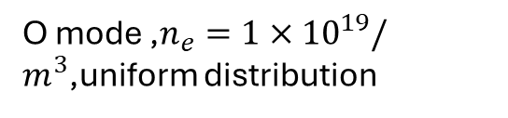





$$B_{0}$$
$$z$$
$$z$$
$$E_{x}$$
$$E_{x}$$
O mode ,$n_{e}={1×10}^{19}/m^{3}$,uniform distribution
X mode ,$n_{e}={1×10}^{19}/m^{3}$,B=1T,
Uniform distribution

Slide 17
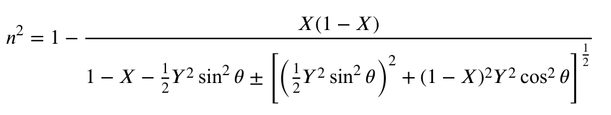




B₀=1T,ne₀=1e19/m3,uniform distribution
$$B_{0}$$
$$θ=\frac{π}{4}$$
$$z$$
$$E_{x}$$
n₊(theory)=0.432
n₊(numerical)=0.429
n₋(theory)=1.128
n₋(numerical)=1.129

